Slide 1

CS244a: An Introduction to Computer Networks
Handout 7:
Congestion Control
Nick McKeown
Professor of Electrical Engineering
and Computer Science, Stanford University
nickm@stanford.edu
http://www.stanford.edu/~nickm

Slide 2
Main points
Congestion is inevitable
Congestion happens at different scales – from two individual packets colliding to too many users
TCP Senders can detect congestion and reduce their sending rate by reducing the window size
TCP modifies the rate according to “Additive Increase, Multiplicative Decrease (AIMD)”.
To jump start flows, TCP uses a fast restart mechanism (called “slow start”!).
Routers slow down TCP senders by buffering packets and thus increasing delay

Slide 3
Congestion
H₁
A₁(t)
10Mb/s
R1
D(t)
1.5Mb/s
H₃
H₂
A₂(t)
100Mb/s
A₁(t)
D(t)
A₂(t)
A₂(t)
X(t)
Cumulative
bytes
A₁(t)
X(t)
D(t)
t

Slide 4
Time Scales of Congestion
Too many users using a
link during a peak hour
7:00
9:00
TCP flows filling up all
available bandwidth
1s
2s
3s
Two packets colliding
at a router
100µs
200µs
300µs

Slide 5
Dealing with Congestion
Example: two flows arriving at a router
A₁(t)
?
R1
A₂(t)
Strategy
Drop one of the flows
Buffer one flow until the other has departed, then send it
Re-Schedule one of the two flows for a later time
Ask both flows to reduce their rates

Slide 6
Congestion is unavoidable
Arguably it’s good!
We use packet switching because it makes efficient use of the links. Therefore, buffers in the routers are frequently occupied.
If buffers are always empty, delay is low, but our usage of the network is low.
If buffers are always occupied, delay is high, but we are using the network more efficiently.
So how much congestion is too much?

Slide 7
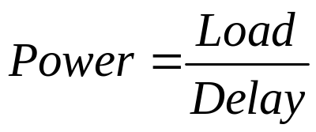
Load, delay and power
Typical behavior of queueing
systems with random arrivals:
A simple metric of how well the
network is performing:
Burstiness tends to move
asymptote to the left
Average
Packet delay
Power
Load
Load
“optimal
load”

Slide 8
Options for Congestion Control
Implemented by host versus network
Reservation-based, versus feedback-based
Window-based versus rate-based.

Slide 9
TCP Congestion Control
TCP implements host-based, feedback-based, window-based congestion control.
TCP sources attempts to determine how much capacity is available
TCP sends packets, then reacts to observable events (loss).

Slide 10
TCP Congestion Control
TCP sources change the sending rate by modifying the window size:
  Window = min{Advertized window, Congestion Window}
In other words, send at the rate of the slowest component: network or receiver.
“cwnd” follows additive increase/multiplicative decrease
  On receipt of Ack: cwnd += 1
  On packet loss (timeout): cwnd *= 0.5
Receiver
Transmitter (“cwnd”)

Slide 11
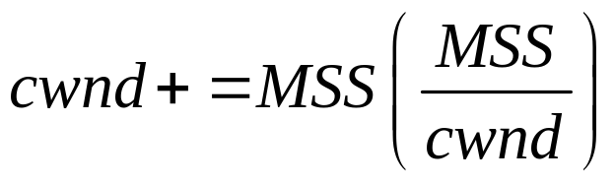
Additive Increase
Src
D
A
D
D
A
A
D
D
D
A
A
A
Dest
Actually, TCP uses bytes, not segments to count:
When ACK is received:

Slide 12
Leads to the TCP “sawtooth”
Window
Timeouts
halved
Could take a long time to get started!
t

Slide 13
TCP Sending Rate
What is the sending rate of TCP?
Acknowledgement for sent packet is received after one RTT
Amount of data sent until ACK is received is the current window size W
Therefore sending rate is R = W/RTT
Is the TCP sending rate saw tooth shaped as well?

Slide 14
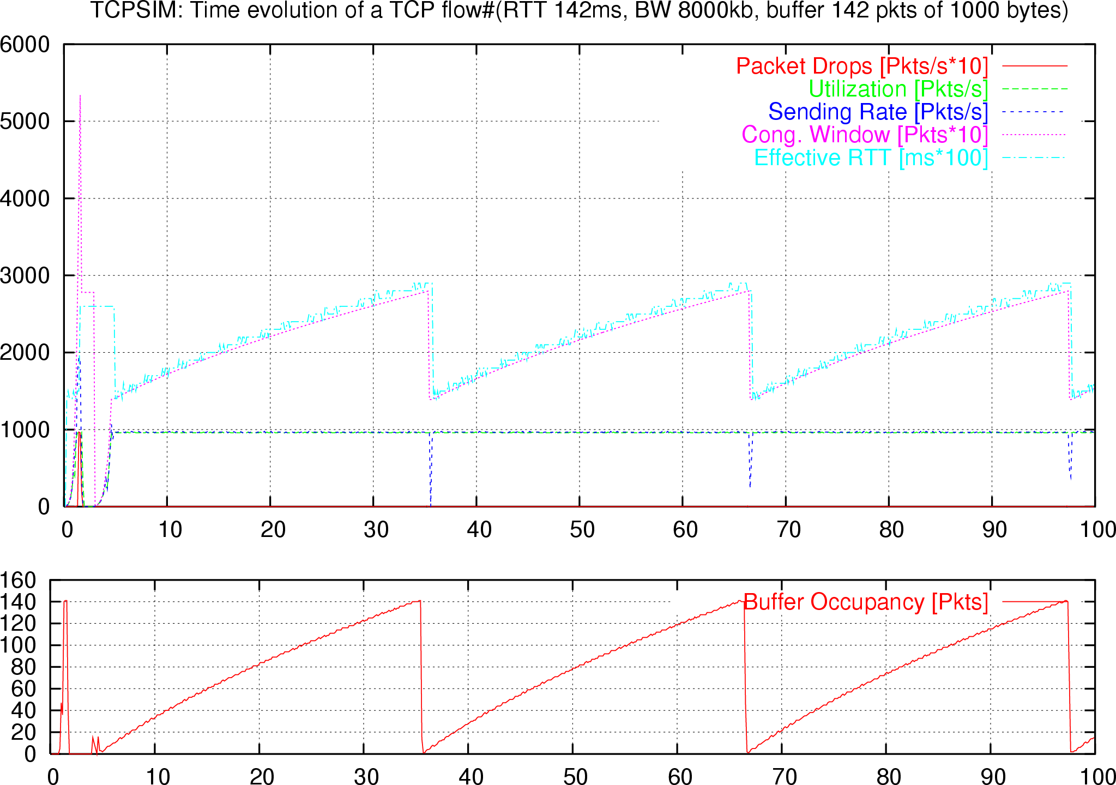
TCP and buffers

Slide 15
TCP and Buffers
For TCP over a network link with enough buffer, RTT and W are proportional to each other
Therefore the sending rate R = W/RTT is constant (and not a sawtooth)
TCP rate can be controlled in two ways:
  Buffering packets and increasing the RTT
  Dropping packets to decrease TCP’s window size

Slide 16
“Slow Start”
Designed to cold-start connection quickly at startup or if
a connection has been halted (e.g. window dropped to zero,
or window full, but ACK is lost).
How it works: increase cwnd by 1 for each ACK received.
1
2
4
8
Src
D
A
D
D
A
A
D
D
D
D
A
A
A
A
Dest

Slide 17
Slow Start
Window
Timeouts
halved
Slow start in operation until it reaches half of previous cwnd.
Exponential “slow start”
t
Why is it called slow-start? Because TCP originally had
no congestion control mechanism. The source would just
start by sending a whole window’s worth of data.

Slide 18
Congestion control in the Internet
Maximum window sizes of most TCP implementations by default are very small
  Windows XP: 12 packets
  Linux/Mac: 40 packets
Often the buffer of a link is larger than the maximum window size of TCP
  A typical DSL line has 200 packets worth of buffer
  For a TCP session, the maximum number of packets outstanding is 40
  The buffer can never fill up
  The router will never drop a packet

